Slide 1
Topic 20 Reciprocating Engine Cycles
Thermodynamics: An Engineering Approach
8th Edition Yunus A. Çengel, Michael A. Boles
McGraw-Hill, 2015

Slide 2
Objectives
Review the operation of reciprocating engines.
Analyze both closed and open gas power cycles.
Solve problems based on the Otto cycles.
Solve problems based on the Diesel cycles.

Slide 3
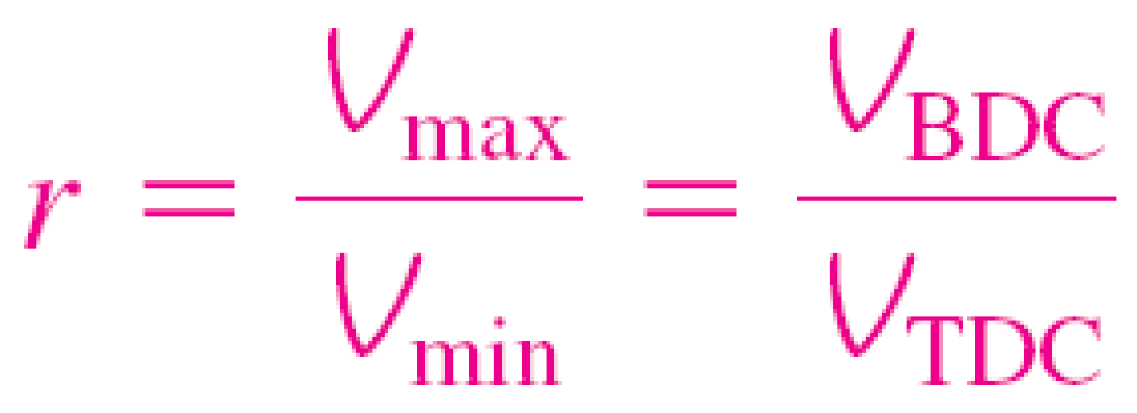
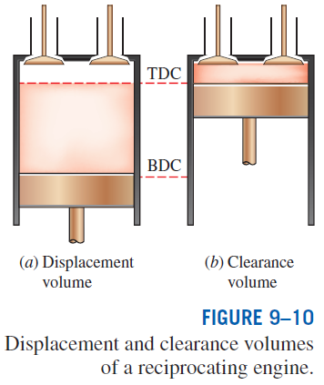
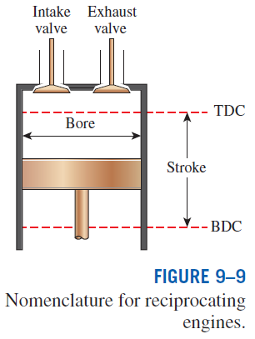
AN OVERVIEW OF RECIPROCATING ENGINES
Compression ratio
Spark-ignition (SI) engines
Compression-ignition (CI) engines

Slide 4
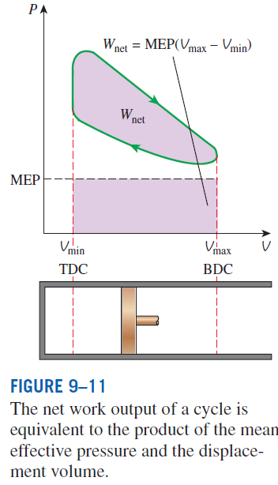

Mean effective pressure
The mean effective pressure can be used as a parameter to compare the performances of reciprocating engines of equal size.
The engine with a larger value of MEP delivers more net work per cycle and thus performs better.

Slide 5
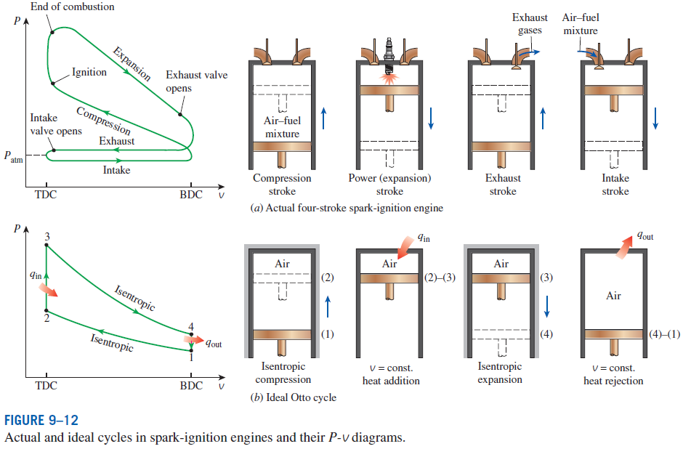
OTTO CYCLE: THE IDEAL CYCLE FOR SPARK-IGNITION ENGINES

Slide 6
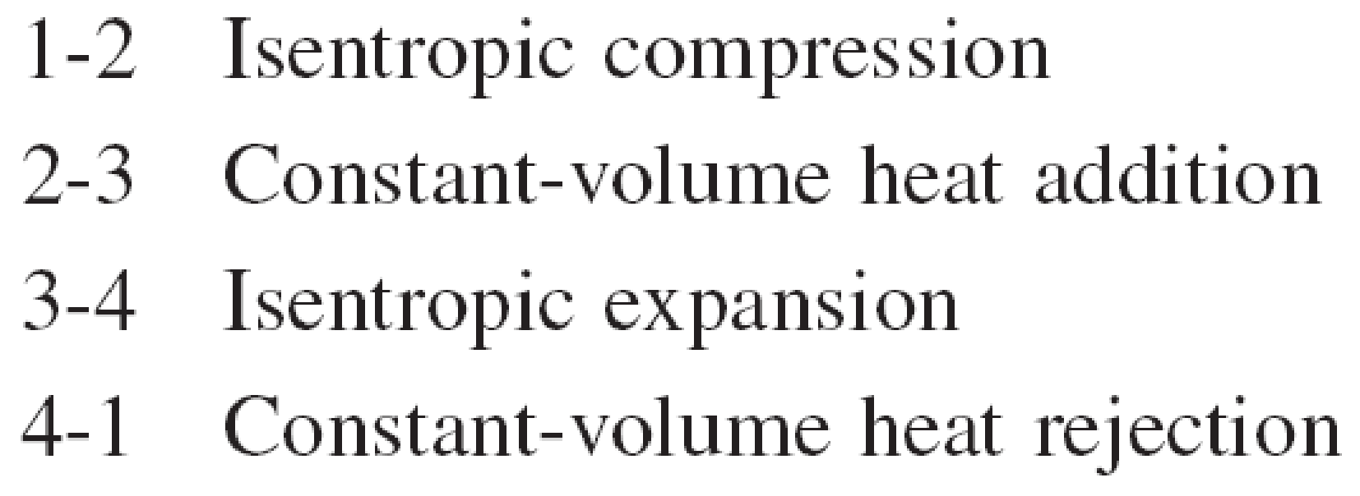
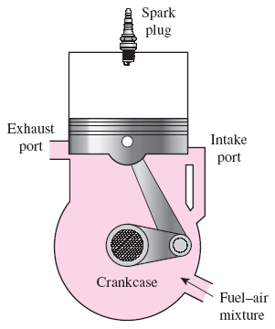
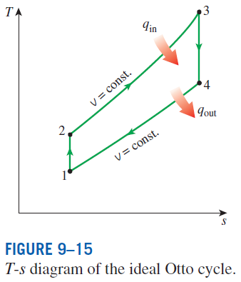
Four-stroke cycle
1 cycle = 4 stroke = 2 revolution
Two-stroke cycle
1 cycle = 2 stroke = 1 revolution
The two-stroke engines are generally less efficient than their four-stroke counterparts but they are relatively simple and inexpensive, and they have high power-to-weight and power-to-volume ratios.
Schematic of a two-stroke reciprocating engine.

Slide 7
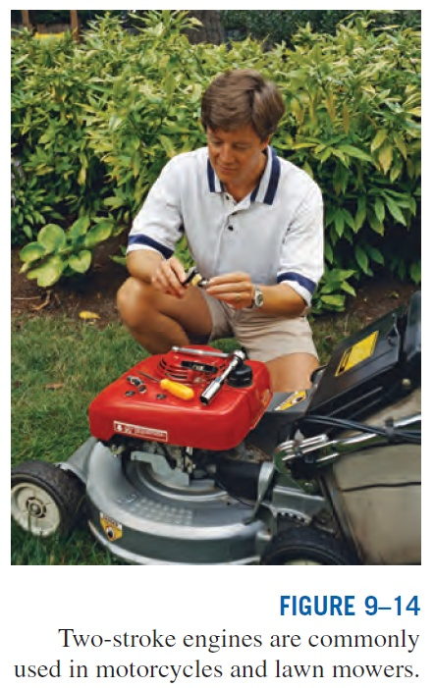

Slide 8
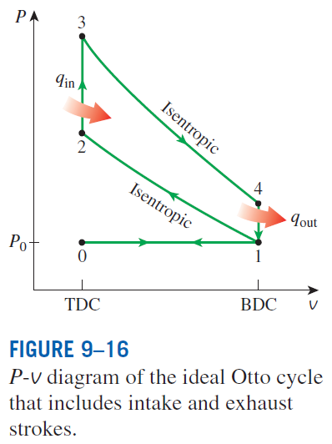
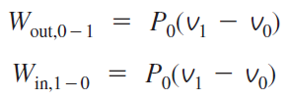
Air enters the cylinder through the open intake valve at atmospheric pressure P₀ during process 0-1 as the piston moves from TDC to BDC.
The intake valve is closed at state 1 and air is compressed isentropically to state 2. Heat is transferred at constant volume (process 2-3); it is expanded isentropically to state 4; and heat is rejected at constant volume (process 4-1).
Air is expelled through the open exhaust valve (process 1-0).
Work interactions during intake and exhaust cancel each other, and thus inclusion of the intake and exhaust processes has no effect on the net work output from the cycle.
However, when calculating power output from the cycle during an ideal Otto cycle analysis, we must consider the fact that the ideal Otto cycle has four strokes just like actual four-stroke spark-ignition engine.

Slide 9
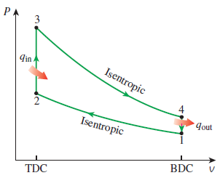
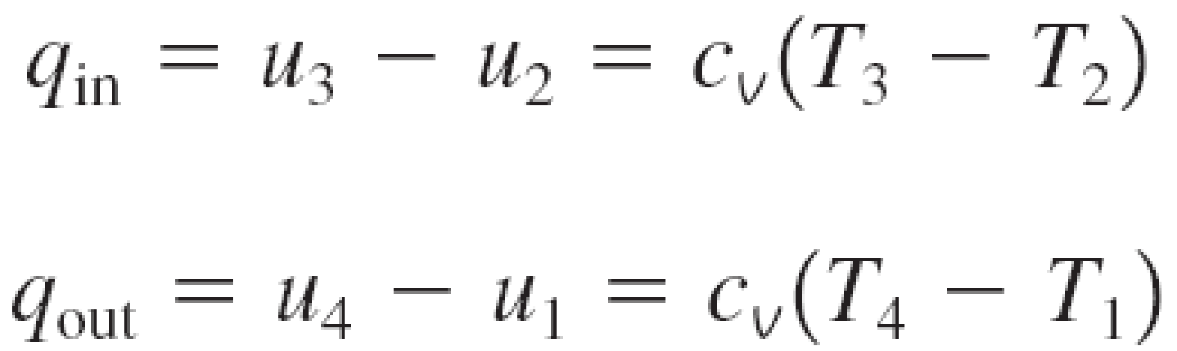


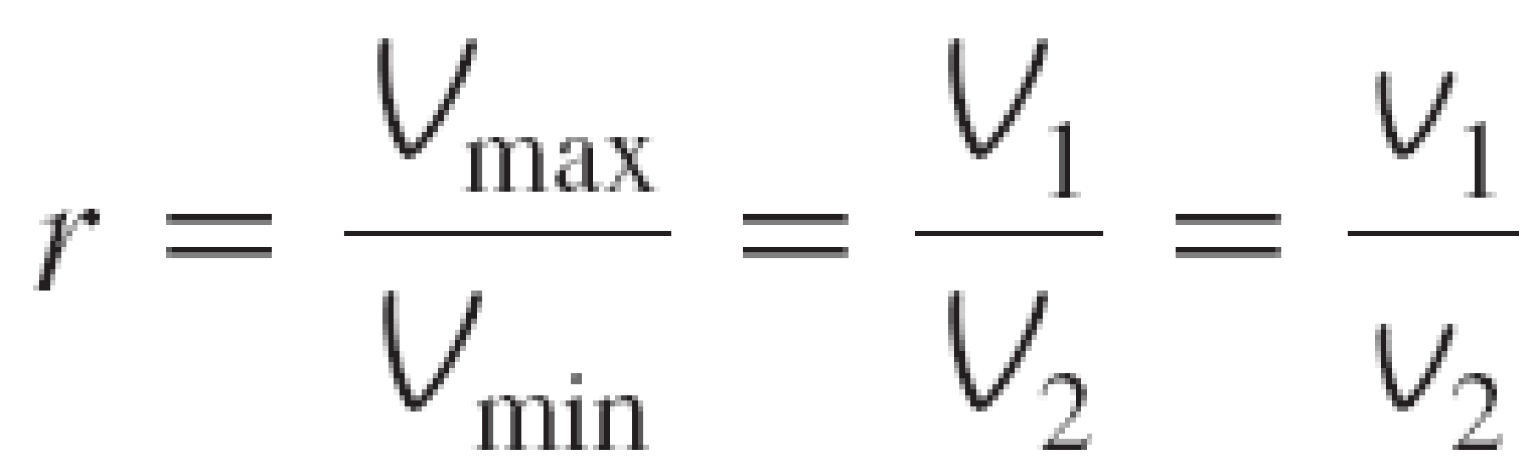
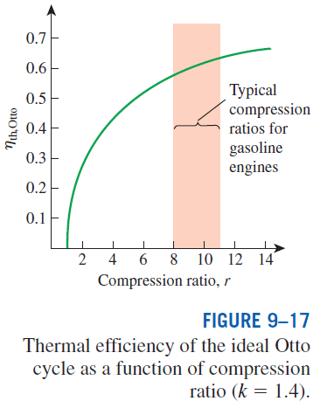

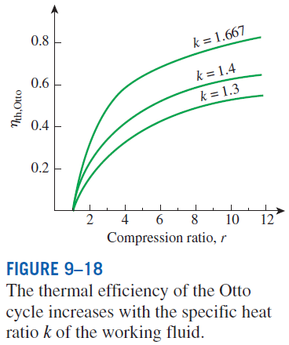
In SI engines, the compression ratio is limited by autoignition or engine knock.

Slide 10
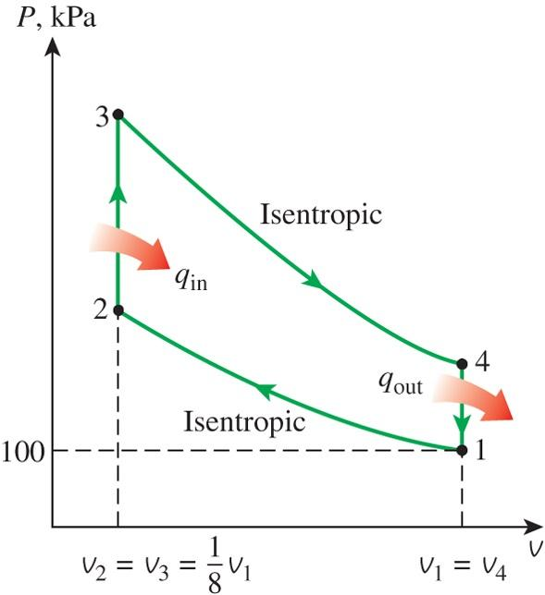
The Ideal Otto Cycle
An ideal Otto cycle has a compression ratio of 8. At the beginning of the compression process, air is at 100 kPa and 17°C, and 800 kJ/kg of heat is transferred to the air during the constant volume heat addition process. Accounting for the variation of specific heats of air with temperature, determine (a) the maximum temperature and pressure that occur during the cycle, (b) the net work output, (c) the thermal efficiency, and (d) the mean effective pressure for the cycle. Also, (e) determine the power output from the cycle, in kW, for an engine speed of 4000 rpm (rev/min). Assume this cycle is operated on an engine that has four cylinders with a total displacement volume of 1.6 L.
Example 1

Slide 11
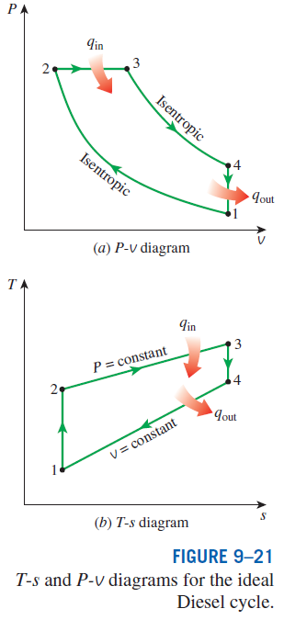
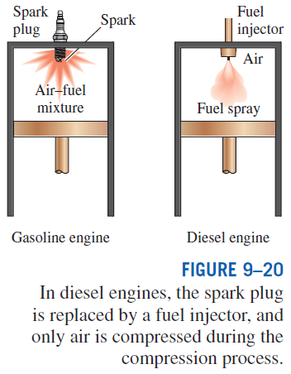
DIESEL CYCLE: THE IDEAL CYCLE
FOR COMPRESSION-IGNITION ENGINES
In diesel engines, only air is compressed during the compression stroke, eliminating the possibility of autoignition (engine knock). Therefore, diesel engines can be designed to operate at much higher compression ratios than SI engines, typically between 12 and 24.
1-2 isentropic compression
2-3 constant-volume heat addition
3-4 isentropic expansion
4-1 constant-volume heat rejection.

Slide 12


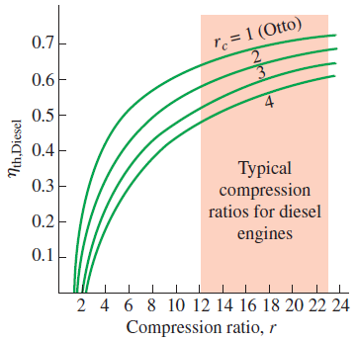
Cutoff ratio
for the same compression ratio
Thermal efficiency of the ideal Diesel cycle as a function of compression and cutoff ratios (k=1.4).

Slide 13
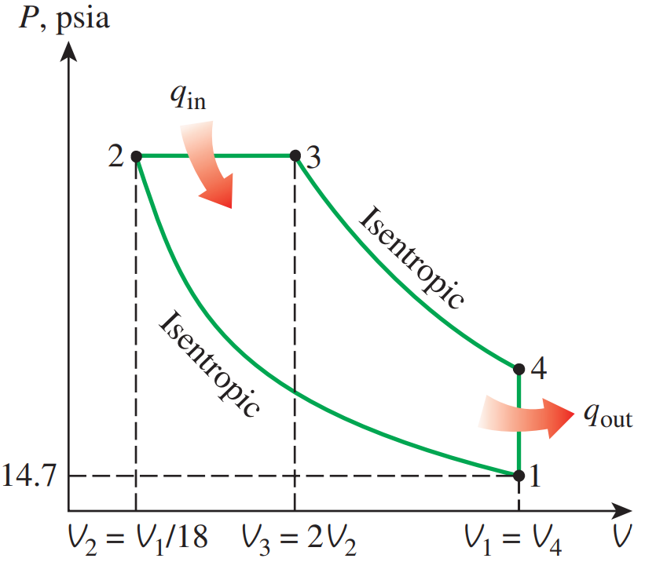
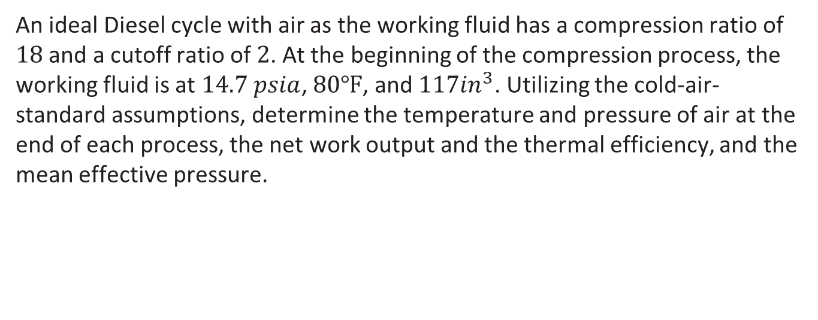
The Ideal Diesel Cycle
An ideal Diesel cycle with air as the working fluid has a compression ratio of $18$ and a cutoff ratio of $2$. At the beginning of the compression process, the working fluid is at $14.7 psia$, $80℉$, and $117{in}^{3}$. Utilizing the cold-air-standard assumptions, determine the temperature and pressure of air at the end of each process, the net work output and the thermal efficiency, and the mean effective pressure.
Example 2

Slide 14
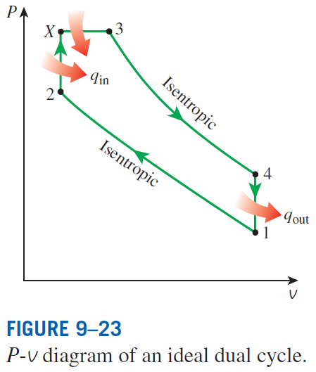
Dual cycle: A more realistic ideal cycle model for modern, high-speed compression ignition engine.
In modern high-speed compression ignition engines, fuel is injected into the combustion chamber much sooner compared to the early diesel engines.
Fuel starts to ignite late in the compression stroke, and consequently part of the combustion occurs almost at constant volume.
Fuel injection continues until the piston reaches the top dead center, and combustion of the fuel keeps the pressure high well into the expansion stroke.
Thus, the entire combustion process can better be modeled as the combination of constant-volume and constant-pressure processes.

Slide 15
Summary
An overview of reciprocating engines
Otto cycle: The ideal cycle for spark-ignition engines
Diesel cycle: The ideal cycle for compression-ignition engines

